Slide 1
Practical JPA
Denis Slaveckij

Slide 2
What is JPA?
Persistence in this context covers three areas:
the API itself, defined in the javax.persistence package;
the Java Persistence Query Language (JPQL);
object/relational metadata.

Slide 3
Domain objects as Java Classes
@Entity
Entity object must be anotated with @Entity.
All nonabstract entities must have either a public or a protected no-argument constructor.
Entity must contain identifier property or properties.
@name- This name is used to refer to the entity in queries.
@Transient
@Transient marks entity property from being persisted.
Field vs property-based persistence
IPB convention is to define annotations on fields.

Slide 4
Persistend data types
Types Examples | Java | EIS coding conventions
Java primitives int | int, double, long | Not used by EIS coding conventions
Java primitives wrappers | java.lang.Integer
String type | java.lang.String
Java API Serializable types | java.math.BigInteger, java.sql.Date
User-defined Serializable types | Class that implements java.io.Serializable
Array types | byte[], char[]
Enumerated type | {OPEN, CLOSED} | Should be used @Enumerated(EnumType.String)
Collection of entity types | Set<Category>
Embeddable class | Classes that are defined @Embeddable

Slide 5
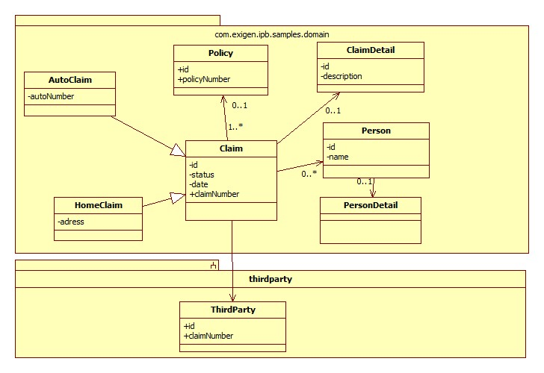
Sample Domain

Slide 6
Identification and @GeneratedValue
Entity must contain identifier property or properties.
@GeneratedValue
Auto
Identity
Sequence
Table
@SequenceGenerator, @TableGenerator
allocationSize property
In EIS Sequence for Oracle, Identity for Mssql.
http://loki/source/xref/eis-default/base/ipb-base/src/main/resources/META-INF/oracle-base-orm.xml

Slide 7
@OneToOne association
@OneToOne association
@Target({METHOD, FIELD}) @Retention(RUNTIME)
public @interface OneToOne {
Class targetEntity() default void.class;
CascadeType[] cascade() default {};
FetchType fetch() default EAGER;boolean optional() default true;
String mappedBy() default "";
}
@JoinColumn

Slide 8
CascadeType and FetchType
CascadeType– defines the set of cascadable operations that are propagated to the associated entity.
ALL- Cascade all operations
PERSIST- Cascade persist operation
MERGE- Cascade merge operation
DELETE- Cascade remove operation
REFRESH- Cascade refresh operation
FetchType- defines strategies for fetching data from the database.
LAZY- is a hint to the persistence provider runtime that data should be fetched lazily when it is first accessed.
EAGER- strategy is a requirement on the persistence provider runtime that data must be eagerly fetched.

Slide 9
@OneToMany
@Target({METHOD, FIELD}) @Retention(RUNTIME)
public @interface OneToMany {
Class targetEntity() default void.class;
CascadeType[] cascade() default {};
FetchType fetch() default LAZY;
String mappedBy() default "";
}
There two possible persistence approaches for maintaining @OneToMany associations between entities:
use relationship table
use id column in child table that references parent

Slide 10
@OneToMany
@JoinColumn
Is used to specify a mapped column for joining an entity association.
Hibernate @IndexColumn
Specifies the ordering of a collection valued association at the point when association is retrieved.
Hibernate DELETE_ORPHAN

Slide 11
@ManyToOne
@Target({METHOD, FIELD}) @Retention(RUNTIME)
public @interface ManyToOne {
Class targetEntity() default void.class;
CascadeType[] cascade() default {};
FetchType fetch() default EAGER;
boolean optional() default true;
}
@JoinColumn,
@PrimaryKeyJoinColumn

Slide 12
@ManyToMany association
@Target({METHOD, FIELD}) @Retention(RUNTIME)
public @interface ManyToMany {
Class targetEntity() default void.class;
CascadeType[] cascade() default {};
FetchType fetch() default LAZY;
String mappedBy() default "";
}

Slide 13
Anotation properties
Element | @OneToOne | @OneToMany | @ManyToOne | @ManyToMany
targetEntity | Yes | Yes | Yes | Yes
cascade | Yes | Yes | Yes | Yes
fetch | Yes (by default true) | Yes (by default false) | Yes (by default true) | Yes (by default false)
optional | Yes | No | Yes | No
mappedBy | Yes | Yes | No | Yes

Slide 14
Inheritance
Single table strategy
In the single-table strategy, all classes in the inheritance hierarchy are mapped to a single table.
@DiscriminatorColumn ,@DiscriminatorValue
Joined-tables strategy
In effect, the joined-tables strategy involves creating separate tables
for each entity in the OO hierarchy and relating direct descendants in the hierarchywith one-to-one relationships.
Table-per-class strategy
In this strategy, both the superclass (concrete class) and subclasses are stored in their own table and no relationship exists between any of the tables.
@MappedSuperClass
Designates a class whose mapping information is applied to the entities that inherit from it. A mapped superclass has no separate table defined for it.

Slide 15
EntityManager
Interface used to interact with the persistence context.
EntityManager methods
Persist, findById, refresh, merge, flush, clear…
EntityManager flush modes
AUTO (default)
COMMIT

Slide 16
Entity lifeCycle

Slide 17
EntityManagerFactory
Method | Purpose
EntityManager createEntityManager() | Creates an application-managed EntityManager.
EntityManager createEntityManager(Map map) | Creates an application-managed EntityManager with a specified Map. The Map contains vendor-specific properties to create the manager.
void close() | Closes the EntityManagerFactory.
boolean isOpen() | Checks whether the EntityManagerFactory is open.
@Version and Optimistic lock strategy

Slide 18
JPQL. Creating Query instance
Method | Purpose
public Query createQuery(String qlString); | Creates a dynamic query using a JPQL statement.
public Query createNamedQuery(String name); | Creates a query instance based on a named query. This method can be used for both JPQL and native SQL queries.
public Query createNativeQuery( String sqlString); | Creates a dynamic query using a native SQL statement with UPDATE or DELETE.
public Query createNativeQuery( String sqlString,Class result-class); | Creates a dynamic query using a native SQL statement that retrieves a single entity type.
public Query createNativeQuery( String sqlString,String result-setMapping); | Creates a dynamic query using a native SQL statement that retrieves a result set with multiple entity types.

Slide 19
JPQL. Query methods
Method Signature | Purpose
public List getResultList() | Retrieves a result set for a query
public Object getSingleResult() | Retrieves a single result or object
public int executeUpdate() | Executes a JPQL UPDATE or DELETE statement
public Query setMaxResults(int maxResult) | Sets the maximum number of objects to be retrieved
public Query setFirstResult( int startPosition) | Sets the initial position for the first result being retrieved by the query
public Query setHint(String hintName,Object value) | Sets a vendor-specific hint for the query
public Query setParameter(String name, Object value) | Sets the value for a named parameter
public Query setParameter(String name, Date value, TemporalType temporalType) | Sets the value for a named parameter when the parameter is of the Date type
public Query setParameter(String name, Calendar value, TemporalType temporalType) | Sets the value for a named parameter when the parameter is of the Calendar type
public Query setParameter(int position, Object value) | Sets the value for a positional parameter
public Query setParameter(int position, Calendar value, TemporalType temporalType) | Set the value for a positional parameter when the parameter is of the Calendar type
public Query setFlushMode(FlushModeType flushMode) | Sets the flush mode

Slide 20
JPQL. Usage in samples
Joining entities
Fetch
Using of constructors in queries.
Aggregation functions.
Bulk deletes and updates.
hibernate.max_fetch_depth- Sets a maximum "depth" for the outer join fetch tree for single-ended associations (one-to-one, many-to-one). A 0 disables default outer join fetching.

Slide 21
References
http://www.manning.com/panda/
http://www.coderanch.com/how-to/content/MZ_SCBCD_5_Study_Guide.pdf
http://en.wikipedia.org/wiki/Java_Persistence_API
Samples can be found
https://github.com/sinedas/jpa-spring-samples

